Slide 1



Cinetix Vision – NextGen Movie Ticket Reservation Platform
CSA-0509 DATABASE MANAGEMENT SYSTEM
Capstone Project Presentation
Presented By
192525336-A Mohammad Naheed
192525103-K Kalyan
192525464-Harsha Vardhan
Guided by
Dr R Kesavan

Slide 2


Abstract
Smart DBMS-driven cinema management platform
Automates movie, theater, show, seat & booking management
Uses AI to understand customer preferences and demand
Dynamic pricing based on real-time demand
Smart offers to reduce unsold seats
Predicts show demand and future revenue
Converts booking data into business decisions

Slide 3

Problem Statement
Traditional movie reservation systems lack personalized recommendations and efficient seat selection, making the booking process time-consuming and less user-friendly. Users also face difficulties in finding suitable movies, showtimes, and available seats quickly.

Slide 4
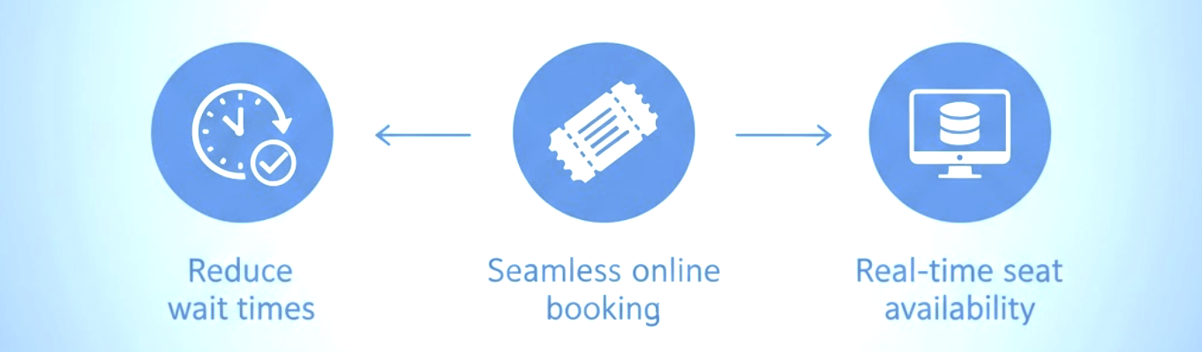
Objectives
Develop a DBMS-based cinema management system
Provide fast and secure ticket reservation
Predict movie/show demand
Introduce dynamic ticket pricing
Generate smart offers for unsold seats
Detect low-performing shows early
Predict revenue and profit

Slide 5
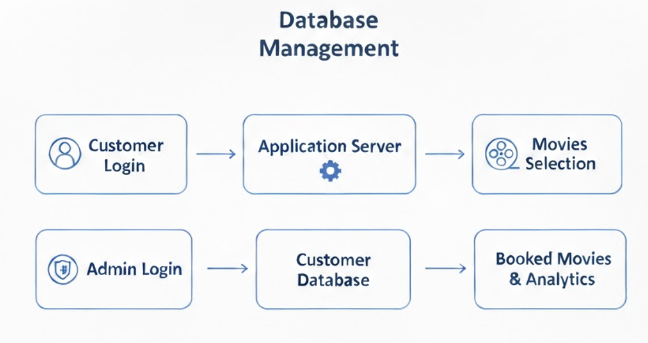
System Architecture / Workflow
User Interface
User registration/login
Movie browsing and seat selection
Application Layer
Booking processing
Seat management
Business rules
Communication between AI & DBMS
Database (DBMS)
Stores user data, movie details, theaters, bookings,
and payments
Workflow
User logs in and searches for movies
AI recommends movies based on preferences
User selects movie, showtime, and seats
System checks seat availability in database
Payment is processed
Booking confirmation is generated

Slide 6
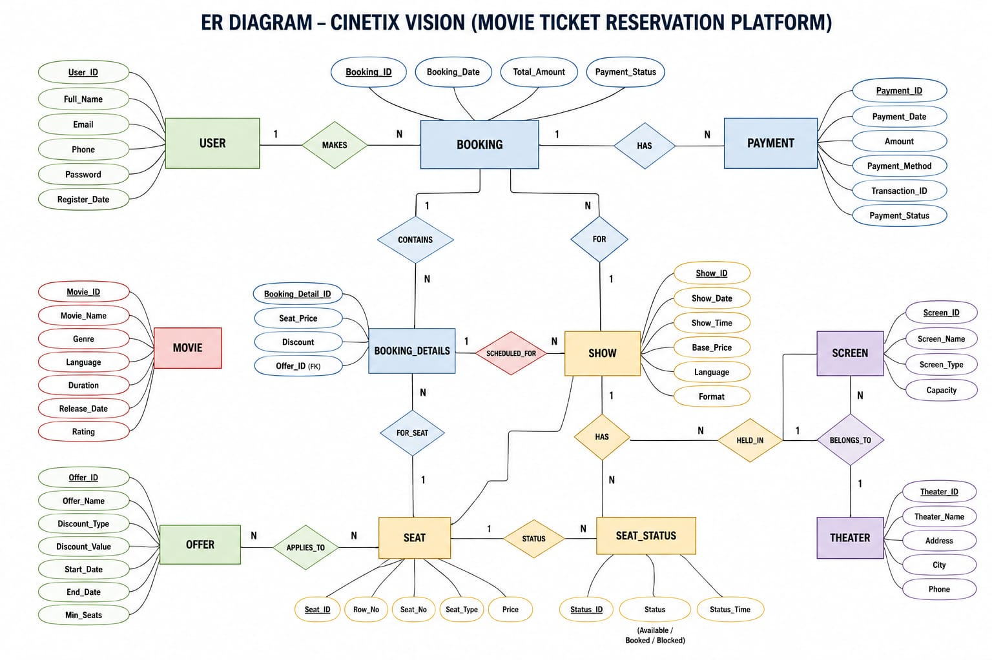
Entity-Relationship(ER)

Slide 7
🚀 Smart Revenue Engine
Dynamic Pricing – Adjust ticket prices based on demand.
Smart Offers – Discount unsold seats before the show.
Dead-Show Detection – Identify low-demand shows early.
Smart Screen Allocation – Match screen size with demand.
Profit Prediction – Forecast revenue and profit for each show.

Slide 8
Module 1 – Admin Portal
Secure admin authentication
Manage movies, theaters & screens
Manage shows and timings
Monitor real-time bookings
Monitor occupancy percentage
View dynamic pricing
Approve/manage smart offers
Identify low-demand shows
View revenue & profit predictions
Generate business reports

Slide 9
Module 1: Final Output / Validation

Slide 10
Module 2: Customer Interface
Secure registration & login
Browse movies and shows
Personalized AI recommendations
Real-time seat availability
Best show recommendation
Price-aware seat/show suggestions
Online payment
Digital ticket
Booking history

Slide 11
Module 2: Final Output / Validation

Slide 12
Module 3 – Staff Portal
Live occupancy
Checked-in customers
Available/occupied seats
Show status
Delayed/cancelled alerts
Booking issues
Operational notifications

Slide 13
Module 3: Final Output / Validation

Slide 14
🧠 Cinema Intelligence
Demand Forecasting – Predict future movie/show demand.
Customer Segmentation – Identify frequent and inactive customers.
Smart Show Selection – Recommend the best show, seat and price.
Business Dashboard – Track occupancy, revenue and performance.
Core Innovation – Turn booking data into business decisions.

Slide 15
Testing & Evaluation
Functional Testing: Verifies user login, movie selection, seat booking, and payment flow.
Database Testing: Ensures data integrity, consistency.
Performance Testing: Evaluates system response time and booking efficiency.
AI Evaluation: Checks accuracy of movie recommendations based on user data and provides discount accordingly.
User Acceptance Testing: Confirms system usability and reliability.

Slide 16
Conclusion
DBMS provides secure and reliable data management
Real-time data improves booking efficiency
Smart Revenue Engine optimizes pricing and occupancy
Cinema Intelligence supports business decisions
Predictive analytics helps cinemas plan ahead
Reduces unsold seats and operational effort
Creates opportunities for higher revenue and better customer satisfaction

Slide 17
References
Acharya, K. (2024). a Case Study on Online Ticket Booking System Project. Available at SSRN 4841210.
BEHRA, H. ONLINE MOVIE TICKET BOOKING SYSTEM (Doctoral dissertation, JAIN UNIVERSITY).
Bui, K. (2022). Application For Booking Movie Tickets Online.
Acharya, K. (2023). a Case Study of Cinema Management System Project. Available at SSRN 4841209.
Hasanaj, E., & Beqiri, L. (2023). Development of the application for cinema management with. net technology.
Lazarevic, S., & Zuvela, T. (2022, March). Design Of Information System To Support Movie Ticket Booking And Cinema Operations. In 2022 21st International Symposium INFOTEH-JAHORINA (INFOTEH) (pp. 1-6). IEEE.
Rizqi, D. I., Utomo, R. G., & Al Makky, M. (2023). Analysis The Impact of E-Service Quality on E-Customer Satisfaction in Cinema Ticket Booking Application. International Journal on Information and Communication Technology (IJoICT), 9(2), 15-28.

Slide 18


